Slide 1
Notes:
I give an example of how my grandmother talks to Siri and Google like they’re her friends.
There are many ways to find information on the Internet, but today we’ll talk about the fastest and most efficient ways to find what you’re looking for.

Slide 2
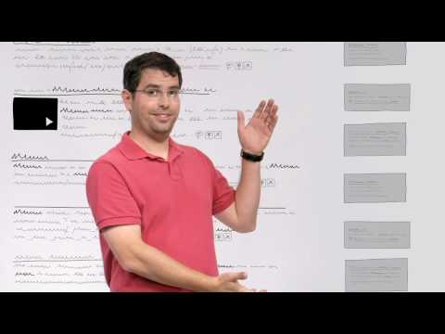
Notes:
Before we learn how to use Google, let’s look at how Google actually works

Slide 3
Notes:
Most of this is covered in the video, but just in case the video doesn’t work.

Slide 4
Notes:
Talk about #4. Google collects information about where you live and where you are and what you’ve searched in the past to customize your search results to help find what you’re looking for. Is that worth the price of Google having your information and selling it? Your data from your school account IS NOT SOLD.
Give example of football. If you live in the USA and search for football you’ll get some results about the NFL. If you live in England you’ll get soccer results. I tested this, and because I went to the University of Michigan and am a big Michigan sports fan, when I searched football I got a news article about Michigan football coach Jim Harbaugh, and the fourth result down was about Michigan football.

Slide 5
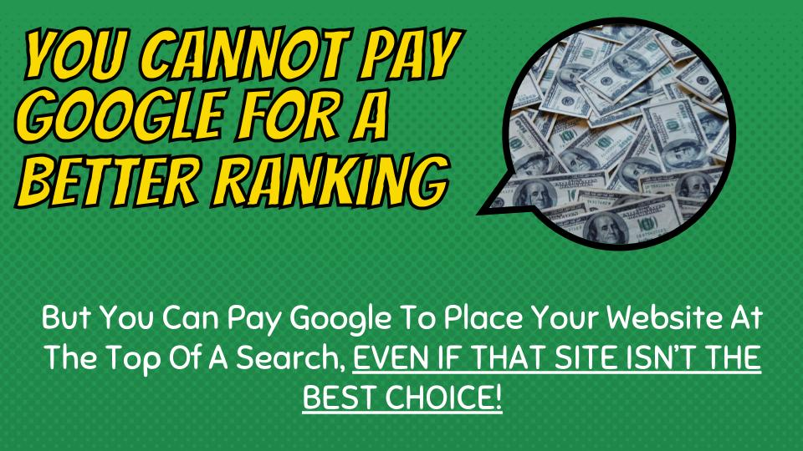
Notes:
You can’t pay Google to place your site higher in their index. The man in the video was correct about that. What he was deceptive about was that if you pay Google enough money they'll put your website ABOVE the index.

Slide 6
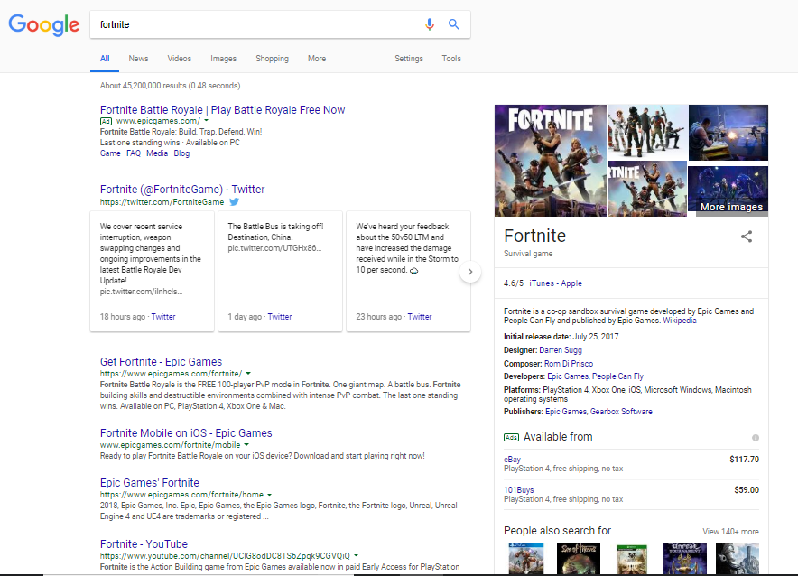
Ads
Notes:
Here’s an example. I Google searched Fortnite, and you can see the #1 result in the index is below the Twitter feed, and the title reads “Get Fortnite - Epic Games.” If you look at the top, however, there is an ad by Epic Games, which appears above the index. This was paid for to be places at the top of the page. The only way you can tell it’s an ad is that it says “ad” in tiny green letters next to the tiny green URL.

Slide 7
Notes:
Let’s take a quick look at something my sweet old Grandma would type into Google. It’s not specific, and it’s asking a question. Do you know who she’s talking about?

Slide 8
Notes:
Google thinks she’s talking about Prince Harry, but that’s not what she wanted.

Slide 9
Notes:
So Grandma goes back into her Google search and decides to ask a different way. This time she asks where Harry is from. It’s still not a lot of information though.

Slide 10
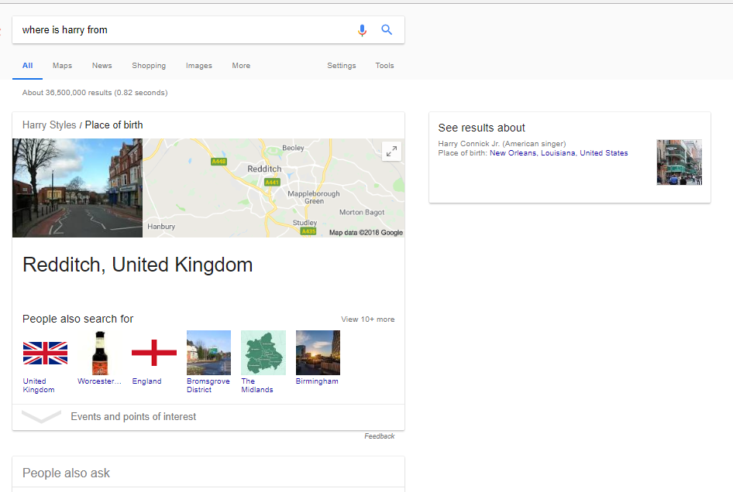
Notes:
This question brings up the results for Harry Styles. Still not what she wants.

Slide 11
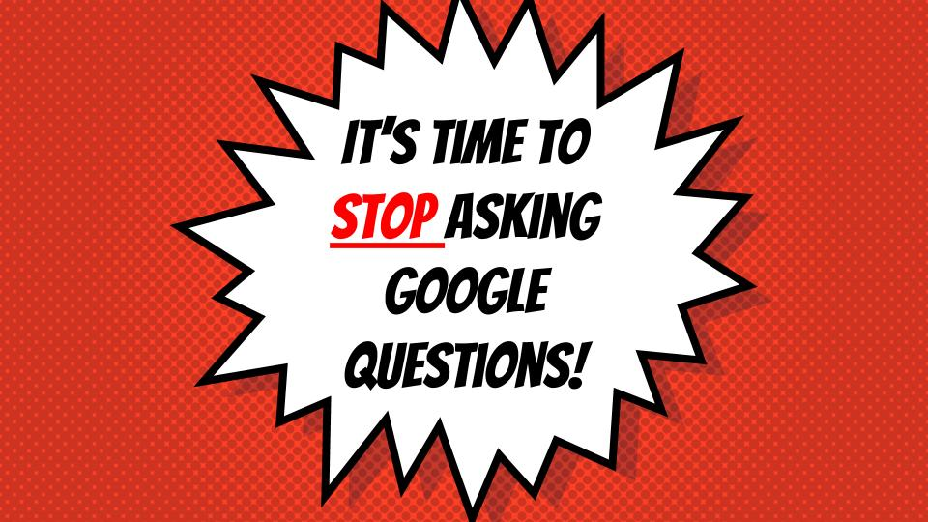
Notes:
Now is the time to stop asking Google questions. Google analyzes every word in your search, so today we’re going to work on ways to be more efficient with our searches. Because as you’ll see in a minute, every word and every letter, even the order of the words will drastically change your search results.

Slide 12
Notes:
Turns out Grandma really wanted to know where Harry Potter lived. Let’s see what happens when she types in Harry Potter Address

Slide 13
Notes:
Like magic, here’s his exact address with some additional information. Think about the specific keywords you need, and leave everything out.

Slide 14
Notes:
So recently my grandmother’s cat started coughing up hairballs everywhere. She wants to know what to do, so she turns to Google.

Slide 15
Notes:
Remember, like many people, my Grandma talks to Google like it’s her friend, so she asks it this questions. If this was you, a smart Googler, what words would you use, and what words would you get rid of?

Slide 16
Notes:
The only words you need here are cat, cough, and furballs. Everything else is uncessary.

Slide 17
Notes:
Here’s another example

Slide 18
Notes:
Here’s another example

Slide 19
Notes:
Here’s another example

Slide 20
Notes:
Here’s another example

Slide 21
Notes:
Here’s another example

Slide 22
Notes:
Here’s another example

Slide 23
Notes:
Now let’s take a look at 4 very specific lessons Google teaches, with examples provided by Google.

Slide 24
Notes:
Every single word you use matters. Let’s first Google search “Who” then “The Who” and finally “A Who”

Slide 25
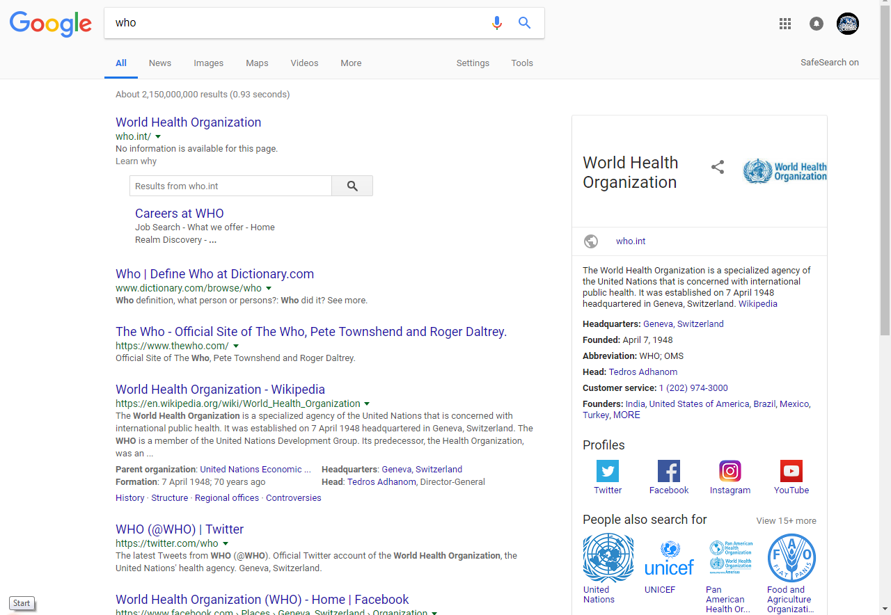
Notes:
Who brings us the World Health Organization

Slide 26
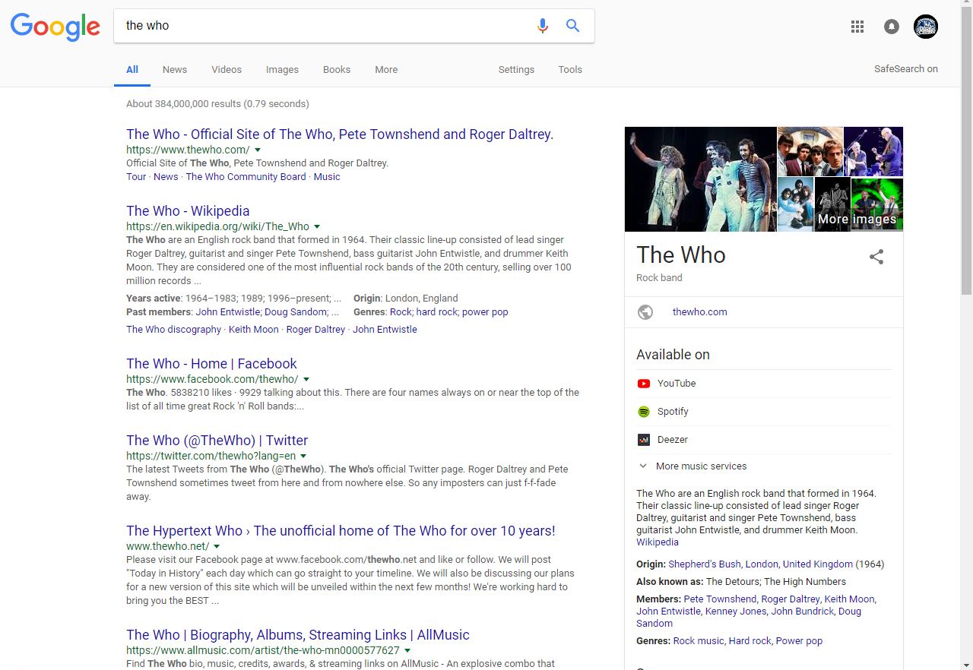
Notes:
The Who brings us a rock band

Slide 27
Notes:
A Who brings us Horton Hears a Who
So you can see that every word, even words like “a” and “the” can change the search results, so this is why asking Google questions is not good practice

Slide 28
Notes:
Now let’s compare the word Zoo to Zoos

Slide 29
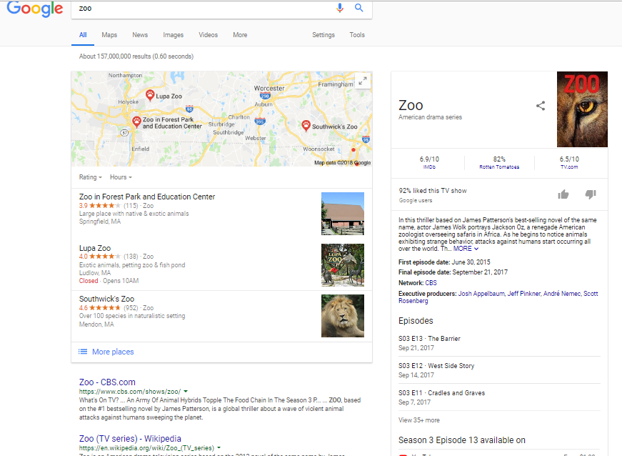
Notes:
Zoo brings up our map of local zoos, but underneath that is a collection of websites about the CBS TV show called Zoo

Slide 30
Notes:
When we type in Zoos, we still have that map, but now we also have websites about the actual zoo facilities, including recent news articles about zoos.

Slide 31
Notes:
The order that you enter the words also makes a big difference. Let’s compare the search blue sky vs sky blue

Slide 32
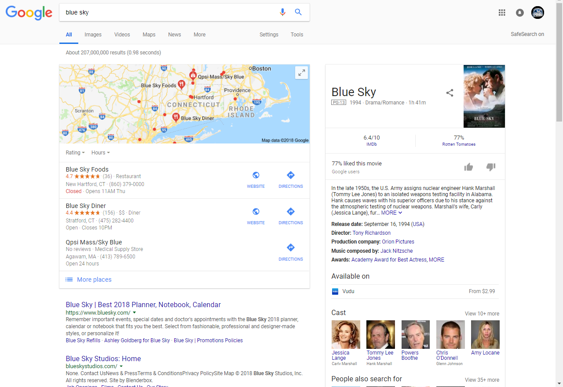
Notes:
Blue sky produces results about a planner, a production studio, and a movie called Blue Sky.

Slide 33
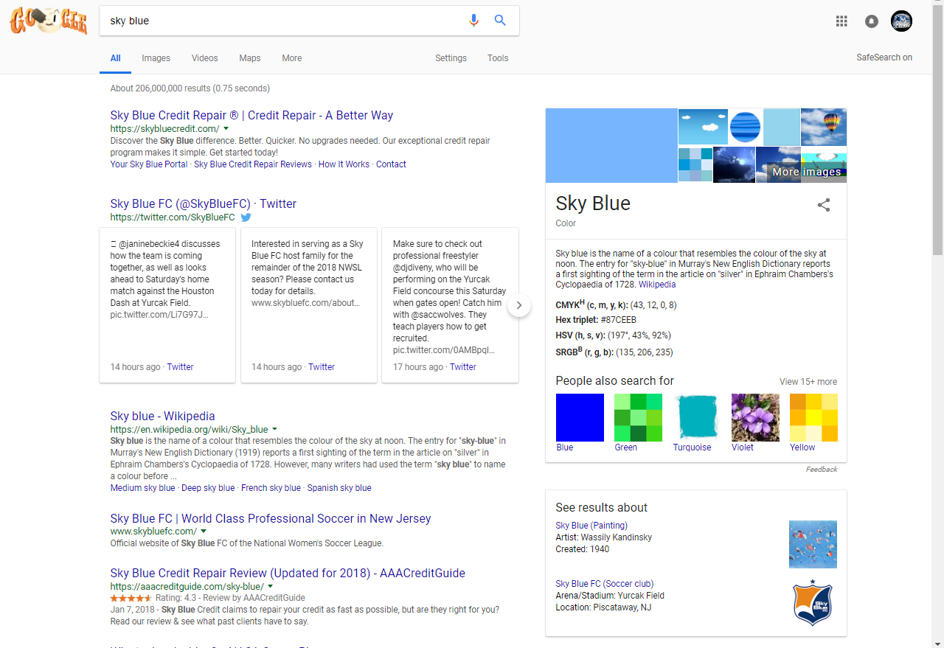
Notes:
Sky blue produces results about a credit repair, the color, and a soccer team

Slide 34
Notes:
Capitalization does not matter when searching. Let’s compare George Washington vs george washington

Slide 35
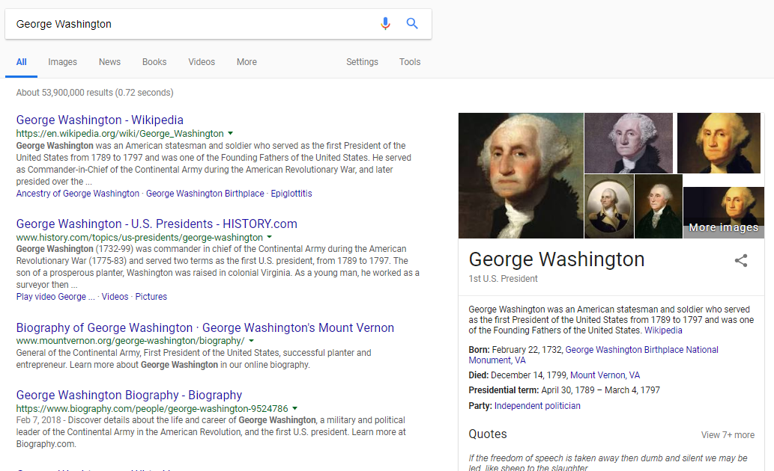

Slide 36
Notes:
They produce the exact same results. Although curiously, not capitalized returned results in .69 seconds compared to .72 seconds

Slide 37
Notes:
If you type in a general search to try and find the name for something, once you discover that name, you should perform a new specific search using the name. So for instance if you search for that thing that connects your tongue to your mouth, once you find that it’s called the frenulum, then you should perform another search for frenulum.

Slide 38
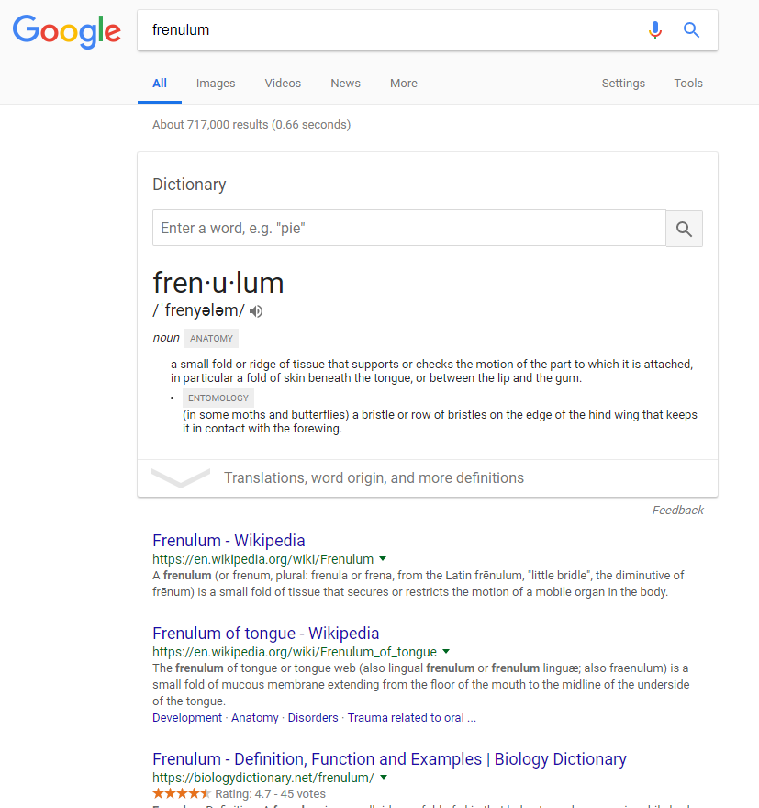
Notes:
This will give you much more specific results

Slide 39
Notes:
Using quotation marks will only return results with websites that have the exact words, in the exact same order as you typed them in between the quotation marks. So let’s say my Grandma wants to find some tips and tricks to beat her friends at Bingo.

Slide 40
Notes:
Typing bingo tips and tricks returns 17 million results. Typing it in quotation marks reduces the results to 5,680, and Grandma knows that every site will contain the exact phrase “bingo tips and tricks”
Beware, if you misspell something in the quotation marks, it will only return results with the word misspelled.

Slide 41
Notes:
You can also use the minus sign to filter your search results and remove references to certain topics. So let’s say I’m doing a report on lions.

Slide 42
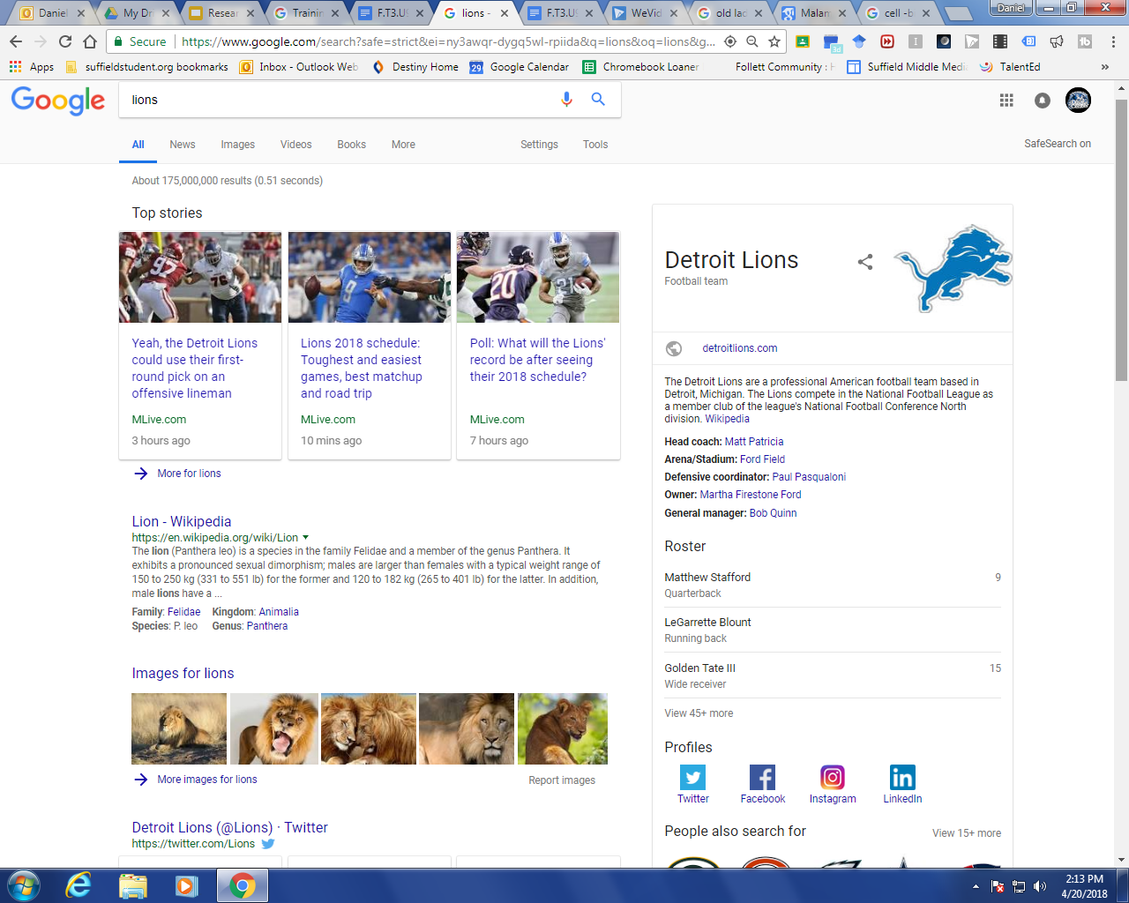
Notes:
When I type in Lions, I get results for the Detroit Lions. Because football is so big in America, I’m going to get many results about football, and that’s not helpful to me.

Slide 43
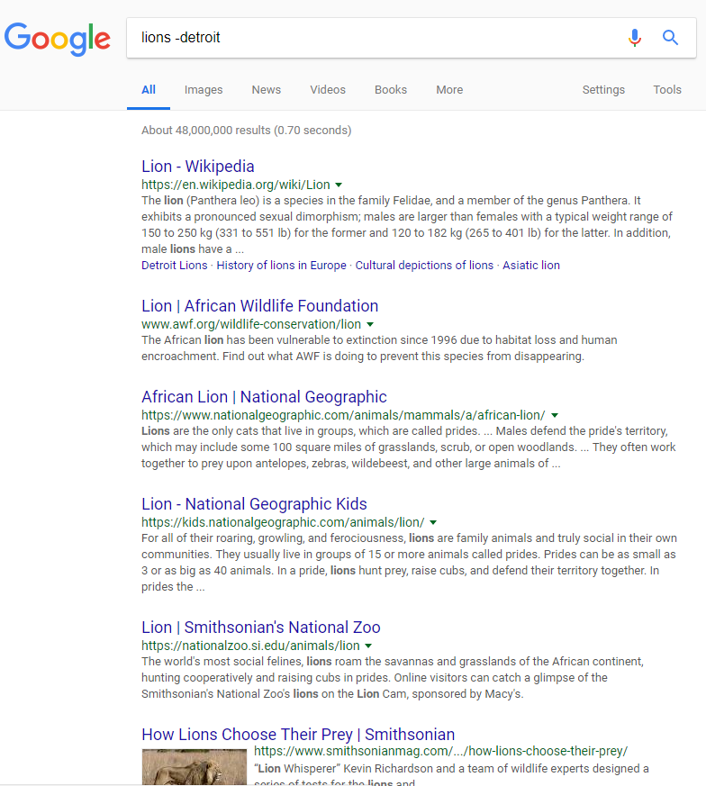
Notes:
If I type lions -detroit, all references to football and the Detroit Lions are gone.
Also think about how I could have changed my keywords

Slide 44
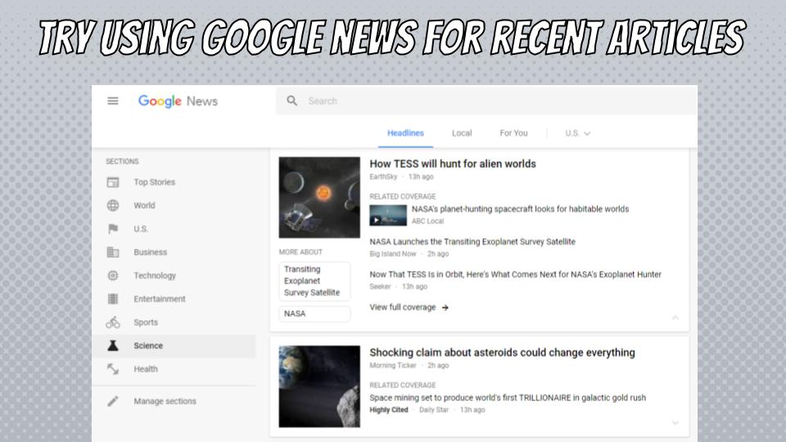
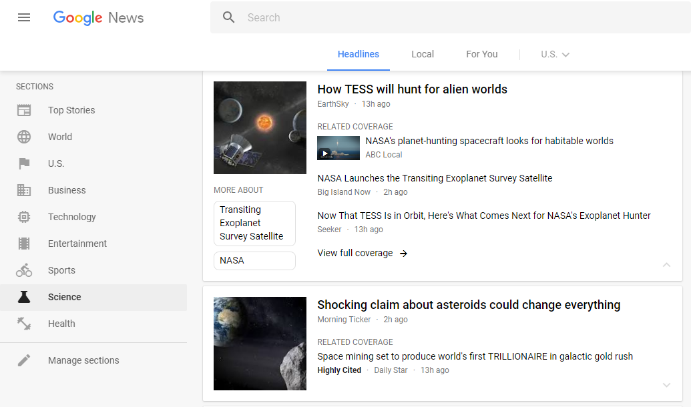
Notes:
Google News is a collection of news articles from across the Internet from sources all over the world. You can browse by topics or search by keywords.

Slide 45
Notes:
You can see if I type in cell phones schools, I get over a million news articles about cell phones in school. One of the nice things about this, is the articles vary in perspective.

Slide 46
Notes:
You can also filter through the search results to only see articles from the past hour, day, week, month, year, or you can type in a custom range.

Slide 47
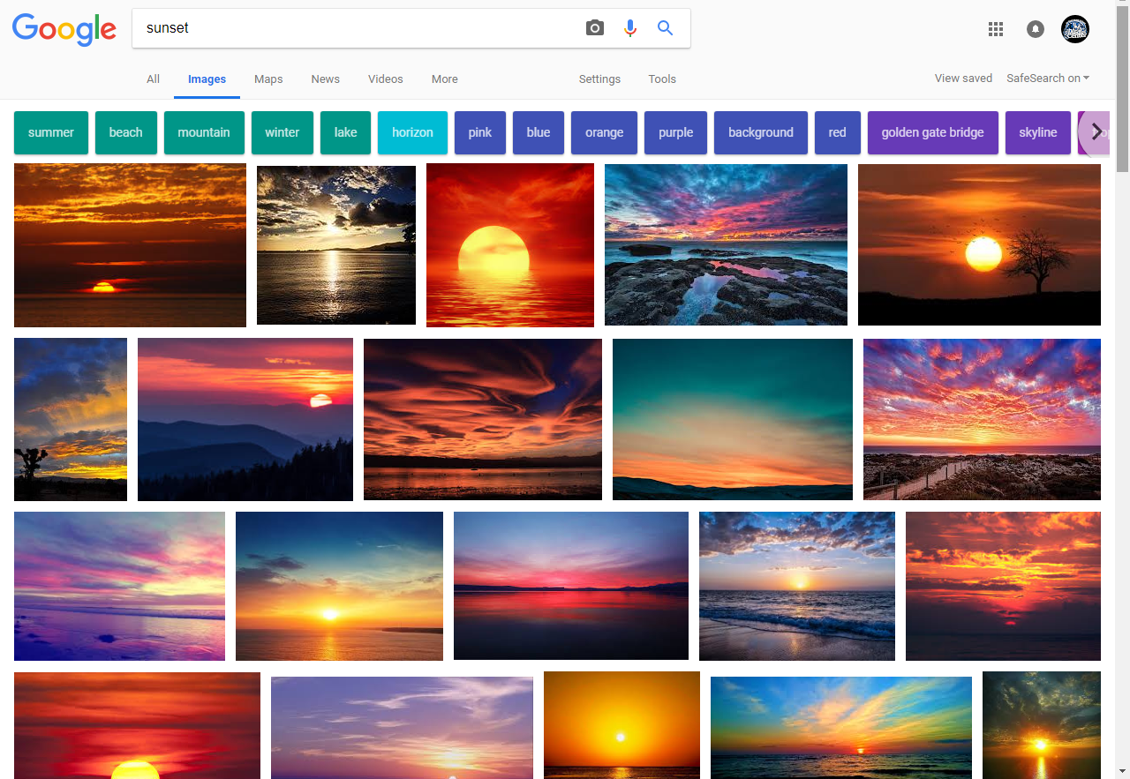
Notes:
One of the tools you may not be aware of is the Google images color filter. Let’s say I am doing a report and want a specific picture of a sunset for my cover page. If I type sunset in the search, I get all kinds of different sunsets.

Slide 48
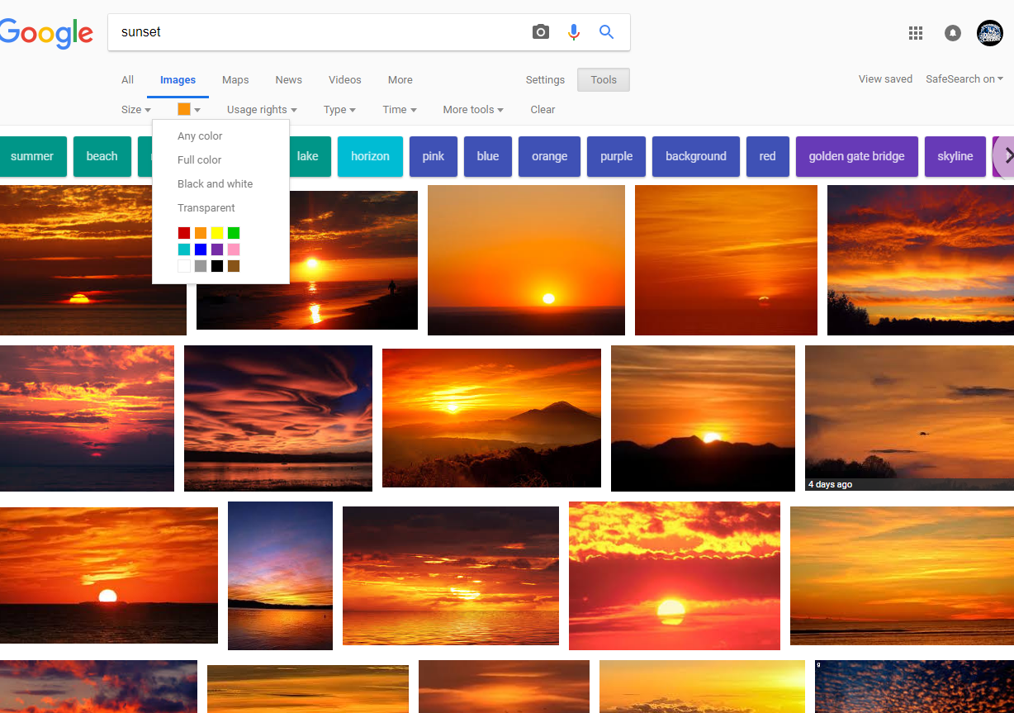
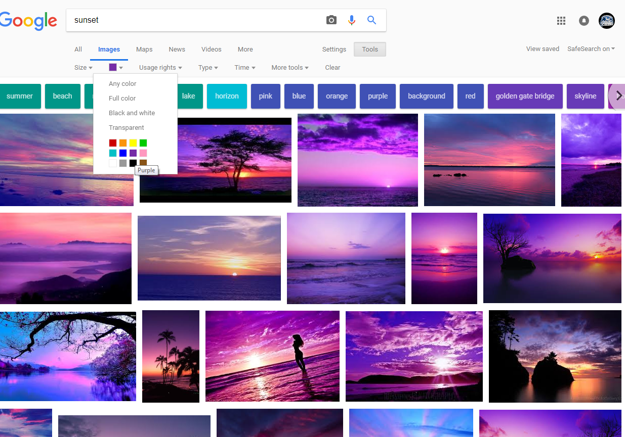
Notes:
If, however, I click on tools, I can then filter by color to find only orange or only purple sunsets.
There’s also a great transparent tool that will give you png or gif files that don’t have a background. This is really handy for anyone who uses pictures for art of thumbnails.

Slide 49
Notes:
Google Scholar is something you probably won’t use until high school and college, but it is something you should know about

Slide 50
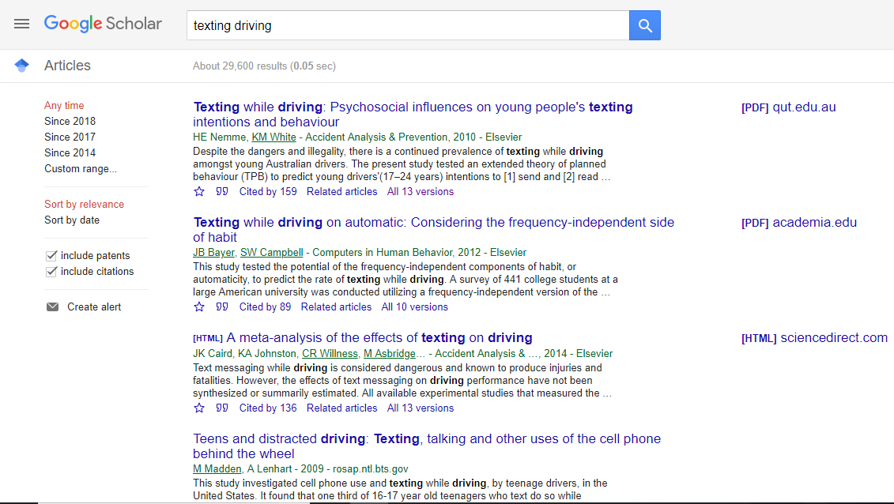
Notes:
Scholar is a collection of over 150 million peer-reviewed articles from academic journals and books, conference papers, theses and dissertations, preprints, abstracts, technical reports, and other scholarly literature.
You may not realize it now, but this is a HUGE research tools. We’ll learn more about this down the road.

Slide 51
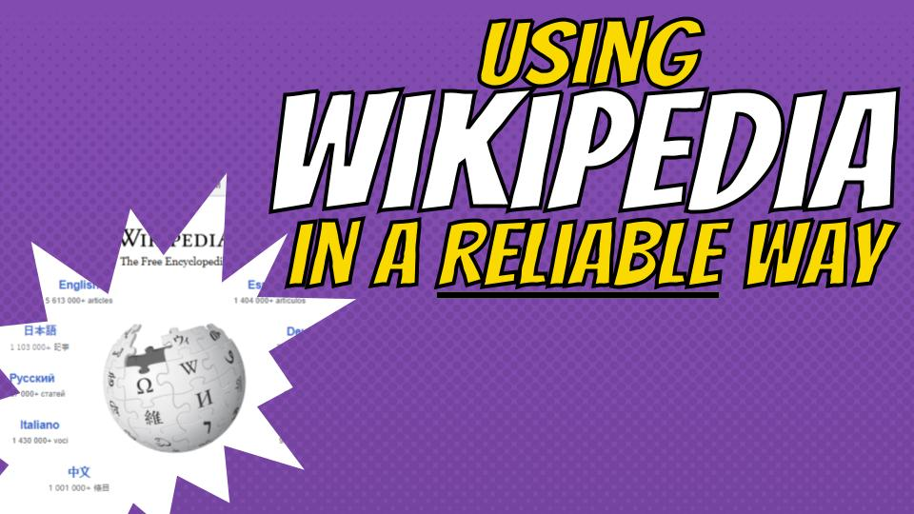
Notes:
We’re going to talk about Wikipedia, but you have to make sure you are paying very close attention, because I’m about to walk you around a bear trap, don’t step in it! You’ve heard your whole lives that Wikipedia is not reliable, but today we’re going to learn how to use it in a reliable way.

Slide 52
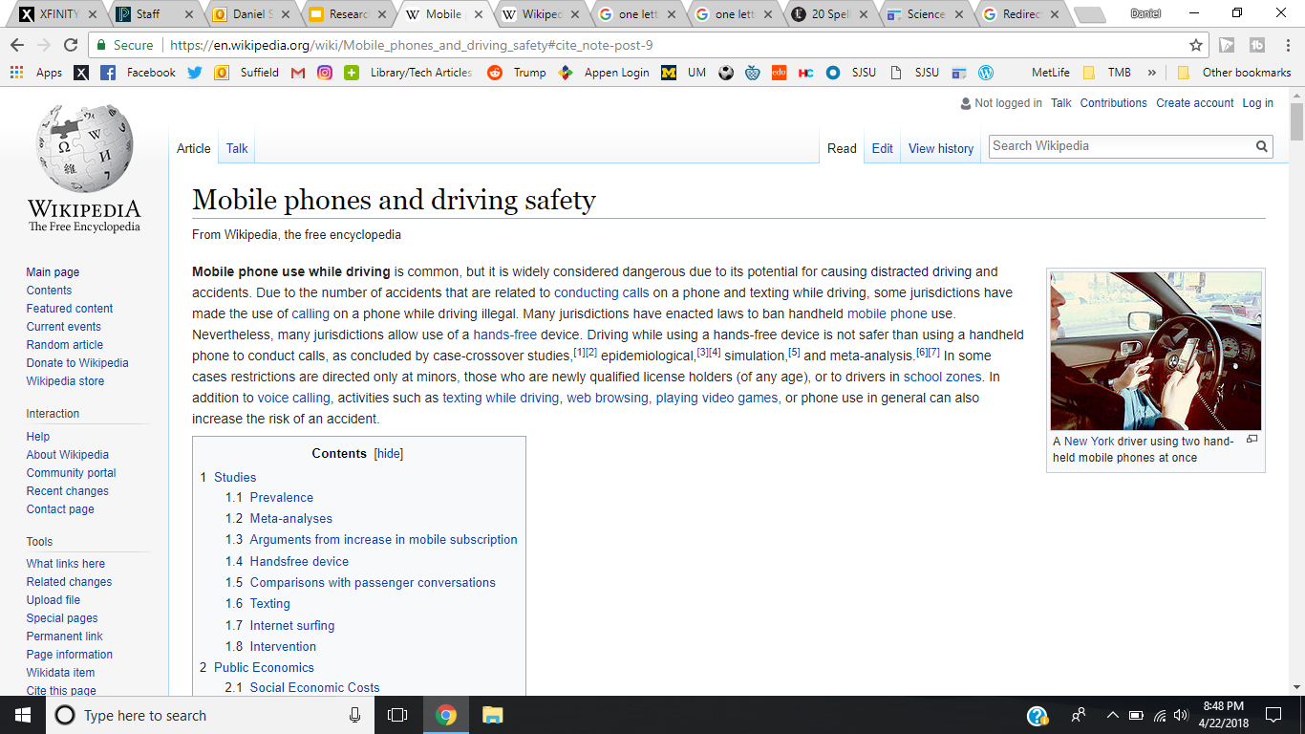
Notes:
You can never cite Wikipedia as a source. Not today, not next year, not in high school, not in college, never! But let’s look at how Wikipedia will lead you to sources you can site.
Here’s an article about mobile phones and driving safety

Slide 53
Notes:
While reading the article, I found this great piece of information that I want to use for my research paper. It turns out State Farm did a study showing 19% of people used the Internet from their phone while driving. I CANNOT use this in my paper. To do so would mean that I am citing that I found this information in Wikipedia.
But do you see that little number nine after the sentence? That is a citation that someone put in saying this information is from another source. Let’s see what happens when I click on the 9.

Slide 54
Notes:
It takes me to the bottom of the article with a citation to a LA Times article. There is also a link to the actual article. Is Wikipedia a credible source you can cite? NO. Is the Los Angeles Times a credible source you can cite? YES. Let’s click on the link.
Side note, if you look below that there is a US DOT National Highway Traffic Safety Administration Distracted Drive Report. This could also be a very useful resource, so you are free to browse through this whole section for more great resources!

Slide 55
Notes:
It takes me to the actual article that the information was taken from. Now you HAVE to go through the article, find that study, and then you can quote it and cite this actual article.

Slide 56
Notes:
You can 100% cite the LA Times article once you find the information inside. You 100% cannot cite the Wikipedia article. We can only use Wikipedia to lead us to the sources.

Slide 57
Advanced Search
For More advanced search techniques visit https://www.google.com/advanced_search

Slide 58
